Slide 1


IT 493 Assignment 6
P roject Schedule Management
Tour Catchers LLC
Team #4

Slide 2

Project Overview
Project: TourCatchers Booking + AI + CRM Integration Sponsor: Sheeraz Ahmed Goal: Implement web booking platform with Bitrix CRM and Dialpad AI integration.
Major Deliverables:
Booking Web App
Bitrix CRM Configuration
Dialpad AI Integration
Admin Dashboard
Full Integration & Production Launch

Slide 3
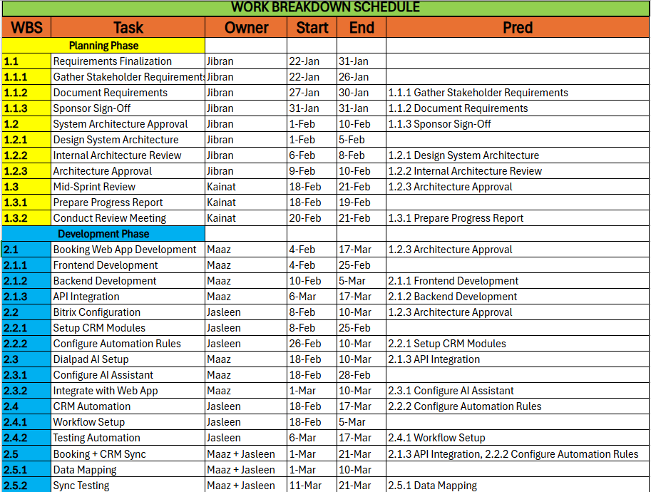
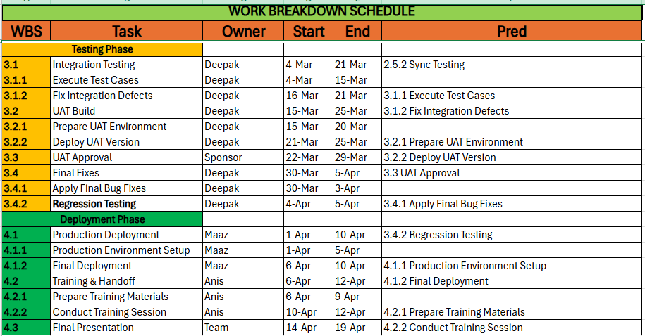
Work Breakdown Schedule (Excel)
Tool Used: Microsoft Excel Work Breakdown Schedule.xlsx
The project plan was developed in Microsoft Excel including:
Level 3 Work Breakdown Structure
Start and End dates
Assigned resources
Dependencies
Critical path tracking

Slide 4
Jibran Ahmad (Team Lead): Overall project coordination, milestone tracking, sponsor alignment.
Maaz Ahmed (Product & Development Lead): Booking web app development, AI integration, deployment management.
Jasleen Kaur (CRM & Process Analyst): Bitrix CRM configuration, automation workflows, CRM integration.
Deepak Pathak (Testing & Quality Manager): Integration testing, UAT management, defect resolution.
Kainat Khan (Communications Manager): Sponsor communication, documentation, sprint reviews.
Anis Mirza (Training Coordinator): User training, handoff support, transition documentation.
Assigned Duty

Slide 5
Critical Path:
Requirements → Architecture → Booking Development → CRM Sync → Integration Testing → UAT → Final Fixes → Production
Why?
These tasks are sequential and dependent. Any delay in these directly delays final deployment and semester completion.
Estimated Critical Duration: Jan 22 – Apr 10 (~11 weeks)
CRITICAL PATH

Slide 6
Burst & Merge Activities
🔹 Burst Activities
(A single activity that leads to multiple subsequent activities)
System Architecture Approval → Leads to Booking Web App Development → Leads to Bitrix Configuration
Booking Web App Development → Leads to Dialpad AI Setup → Leads to Booking + CRM Sync
🔹 Merge Activities
(An activity that requires multiple predecessor tasks before it can begin)
Booking + CRM Sync ← Requires Booking Web App Development ← Requires Bitrix Configuration
Integration Testing ← Requires Booking + CRM Sync
Production Deployment ← Requires Final Fixes

Slide 7
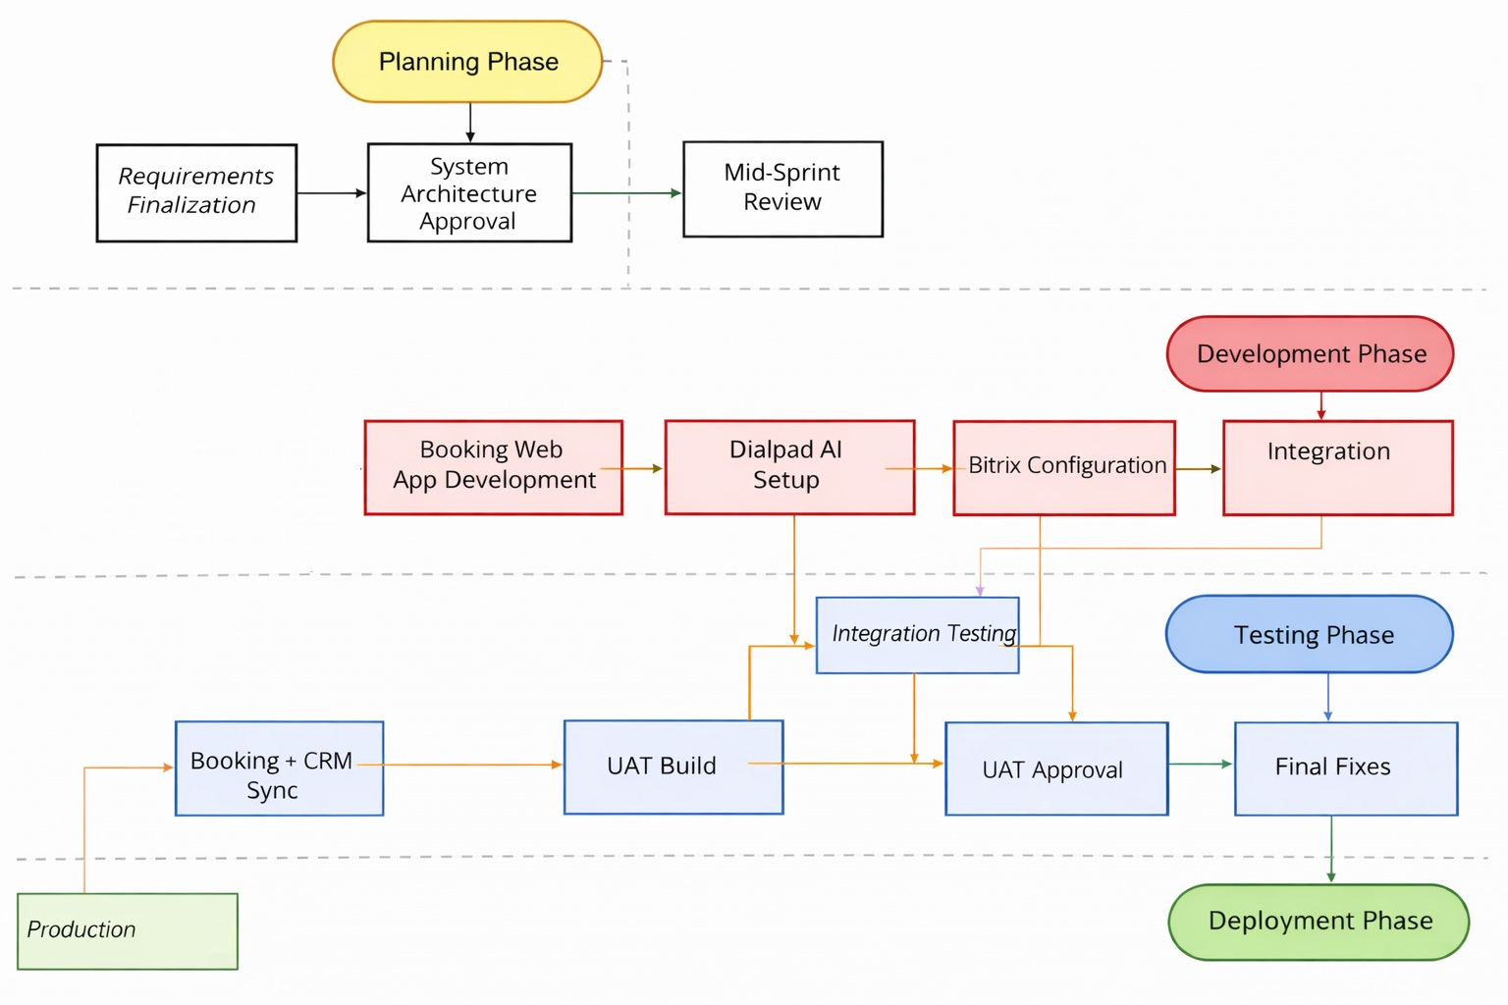
Network Diagram

Slide 8
Activity Dependencies
🔹 Key Dependencies Identified
Requirements Finalization → System Architecture Approval
Architecture Approval → Development Activities
Booking Web App & Bitrix Configuration → Booking + CRM Sync
Booking + CRM Sync → Integration Testing
Integration Testing → UAT → Final Fixes
Final Fixes → Production Deployment
🔹 Parallel Activities
Booking Web App Development and Bitrix Configuration run in parallel.
AI Setup and CRM Automation occur during development phase.
🔹 Critical Path
Requirements → Architecture → Development → Sync → Testing → Deployment

Slide 9

Risks & Mitigation Strategy
🔹 Identified Risks
Development delays
Integration issues between Booking & CRM
UAT approval delays
Sponsor availability constraints
🔹 Mitigation Strategies
Weekly sponsor check-ins
Mid-sprint review for early issue detection
Parallel development where possible
Buffer time before deployment
Clear task ownership and milestone tracking

Slide 10
Citation and References
Project Management Institute (PMI). (2021). A Guide to the Project Management Body of Knowledge (PMBOK® Guide) – 7th Edition. Project Management Institute. → Used for schedule management, WBS structure, critical path, and dependency analysis concepts.
George Mason University – IT493 Course Materials. (2025). Module 3–6: Project Schedule Management, WBS Development, and Network Diagrams. → Used for assignment requirements, burst/merge activity definitions, and schedule documentation standards.
George Mason University – IT493 Assignment 6: Project Schedule Management Guidelines. (2025). → Used to structure WBS to Level 3, identify dependencies, define critical path, and assign resources.
TourCatchers LLC – Business Requirements & Sponsor Meetings. (2026). Internal project documentation. → Used to define scope, development activities, testing phases, and deployment timeline.
Microsoft Excel (2025). Schedule tracking and dependency mapping tool used for project timeline creation.

